Slide 1

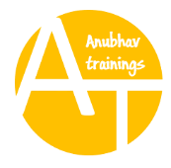
SAP S/4HANA Training
MASTER DATA GOVERNANCE (SAP MDG)
Neeraj Gupta
Session 18
SAP MDG – Data Replication Framework

Slide 2
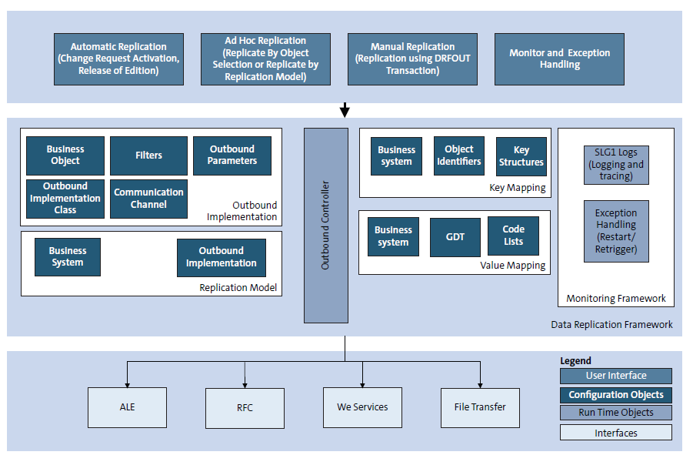
Components of Data Replication Framework
18
SAP MDG – Data Replication Framework

Slide 3
Filter Objects assigned to Tables
18
SAP MDG – Data Replication Framework

Slide 4
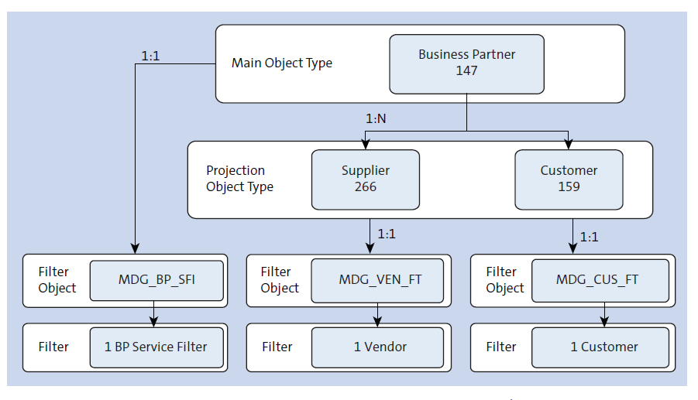
Relationships: Business Objects, Filter Objects and Filters
18
SAP MDG – Data Replication Framework

Slide 5
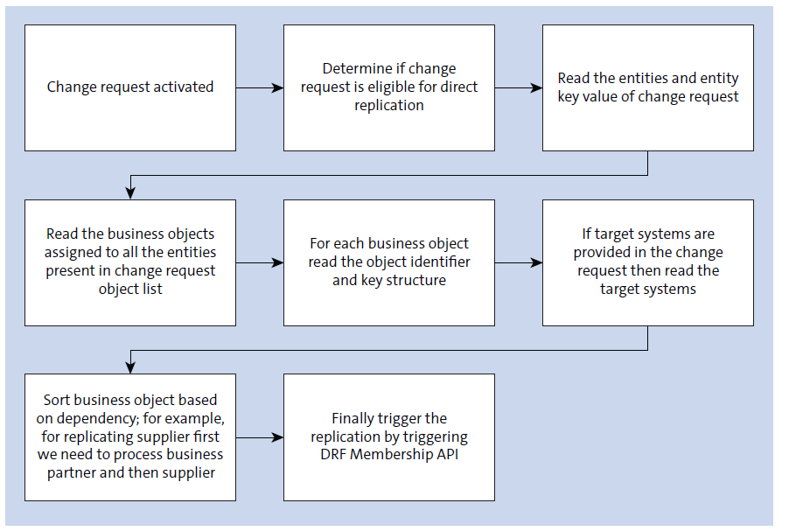
Replication Modes: Direct / Automatic Replication
18
SAP MDG – Data Replication Framework

Slide 6
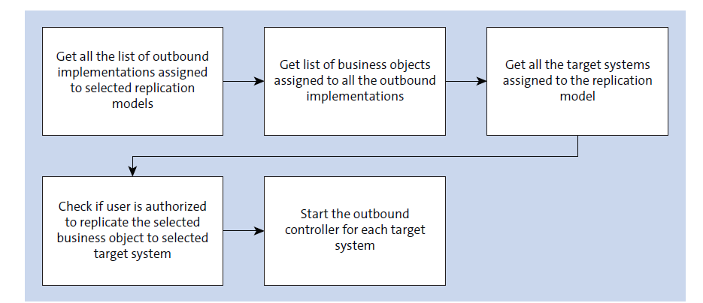
Replication Modes: Ad Hoc Replication (Application name: DRF_AD_HOC_REPLICATION)
18
SAP MDG – Data Replication Framework

Slide 7

End of Session18

Slide 8

Questions

Slide 9

Neeraj gupta

Slide 10


We’re committed to empower you to be
Most Desirable Resource
through powerful training solutions.
We build the workforce of the future.
250+
Corporate Clients
30,000+
Learners Trained
25000+
Learners Placed
FREE WEBINARS
Sign up for free webinars with industry experts every fortnight!
Enroll Now!
Contact us today!
https://anubhavtrainings.com/

Slide 11




More from AnubhavTrainings.com

